Slide 1
iSKKUBot
RAG-based Multilingual Chatbot for Exchange Students at SKKU

Slide 2

EQUIPO SASHIMI
GeonWoo Bang
JeongYoon Hwang
Jiae Choi
Mikel Larrarte Rodriguez

Slide 3
Table of contents.
01
Progress
What have done, what will be done
02
Technical Background
Background of our project(RAG)
03
RAG
Progress on implementing RAG
04
Scraping
Progress on scrapping the web

Slide 4
Progress
01
What is done and what will be done

Slide 5
Timeline
 | Week 6 | Week 7 | Week 8 | Week 9 | Week 10 | Week 11 | Week 12 | Week 13 | Week 14 | Week 15
Scrap form Web/PDF |  | done
Construct Database |  | done
Implement RAG(Retriever) |  |  | In progress
Implement RAG(Generator) |  | In progress
Evaluate
Implement Back-end
Implement Front-end

Slide 6
Role distribution
1. Scraping & Constructing Database
- Jiae, Jungyoon
2. Implementing RAG
Retriever: Mikel
Generator: Geonwoo

Slide 7
Technical Background
02
Technical Background of RAG

Slide 8
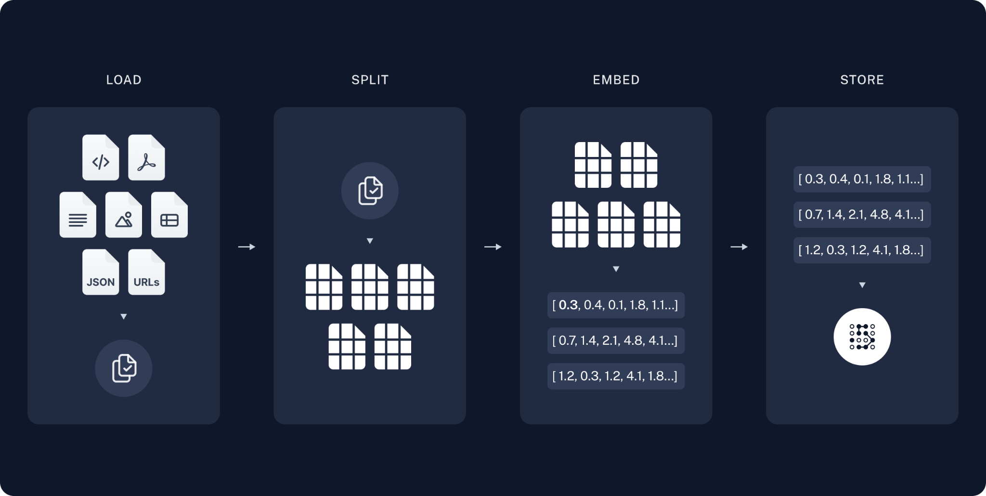
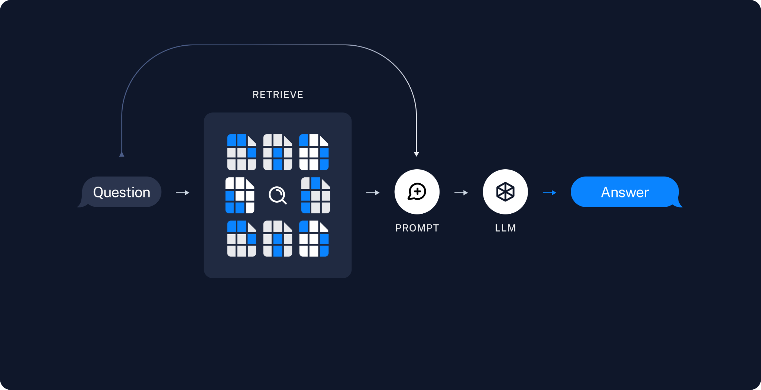
Technical Background
RAG applications have two components:
Indexing: Pipeline for obtaining data from a source and indexing it.
Retrieval & Generation: Actual RAG chain → Takes user’s real-time query and retrieves relevant data from the index (Retriever) + passes to the model (Generator).

Slide 9

Technical Background
Indexing:
Load: Use Document Loader to load our data.
PDFs → PyPDFLoader
Web → WebBaseLoader
Split: Use

Slide 10
RAG
03
Retrieval Augmented Generation

Slide 11
RAG

Slide 12
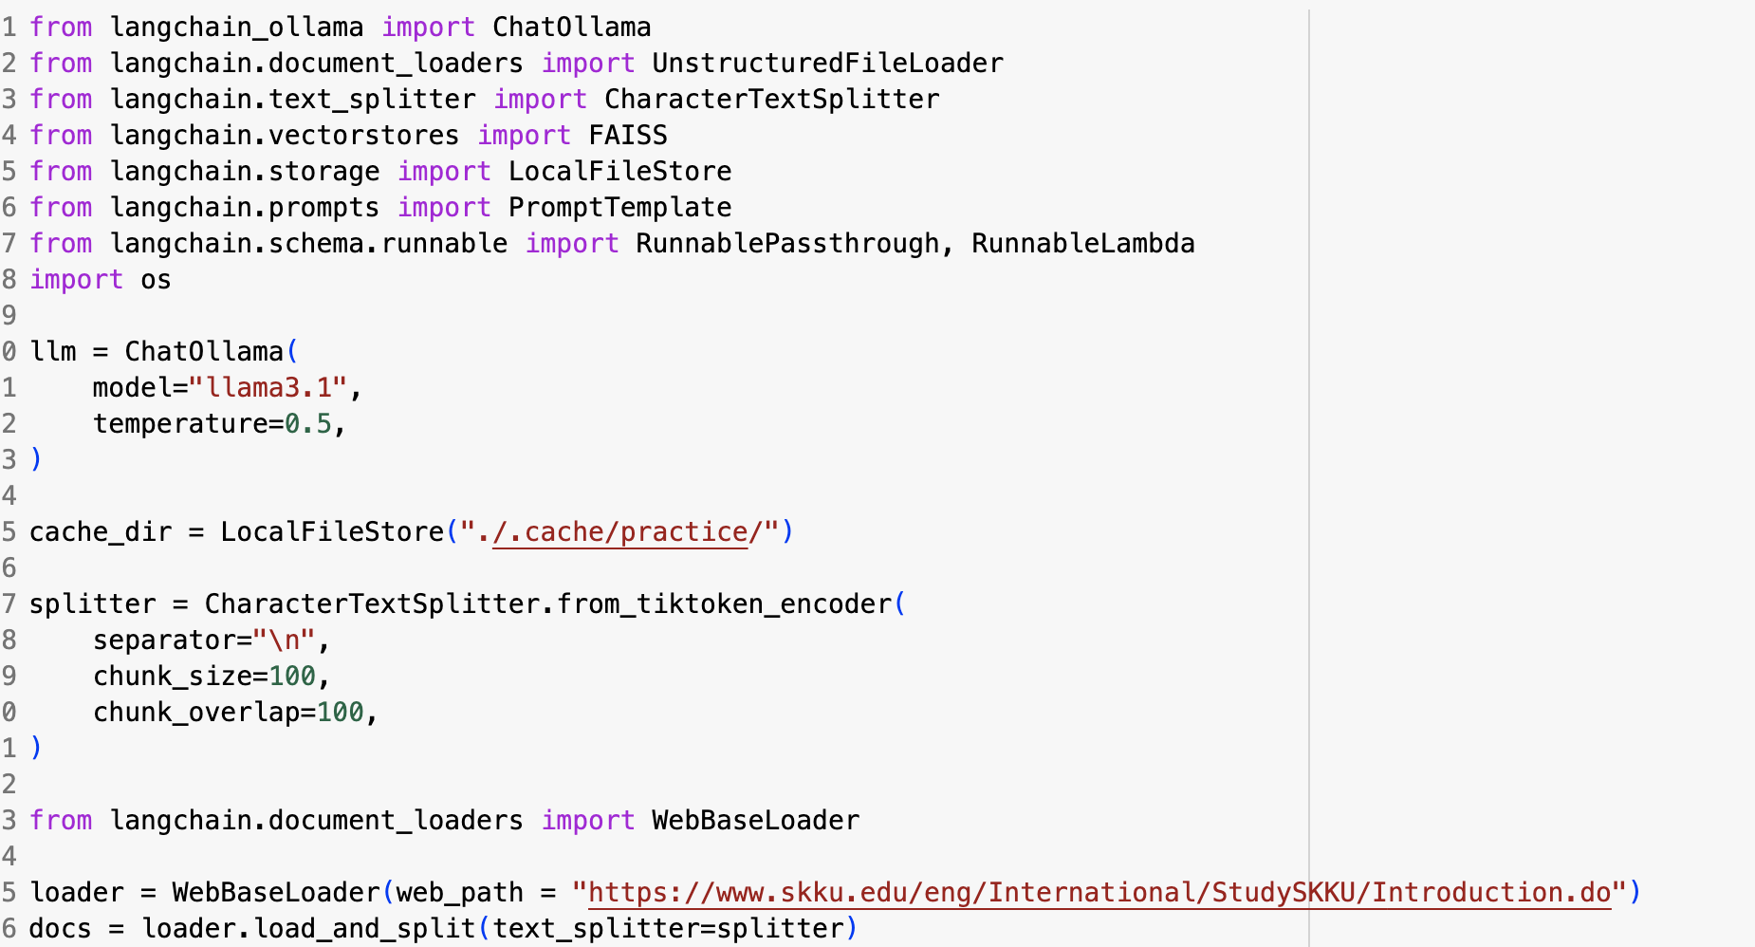
RAG – Generator
Basic Langchain-Ollama demo test
Using Basic Llama-3.1 8b
Use basic Local Storage (connection to external database will be done next week)
Exchange Student’s Introduction
page was used for demo

Slide 13
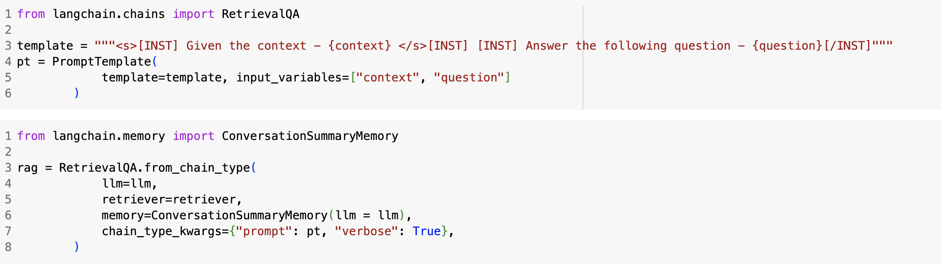
RAG – Generator
Basic Langchain-Ollama demo test
Use FAISS for context similarity search
Use Langchain’s Retrieval QA Module

Slide 14
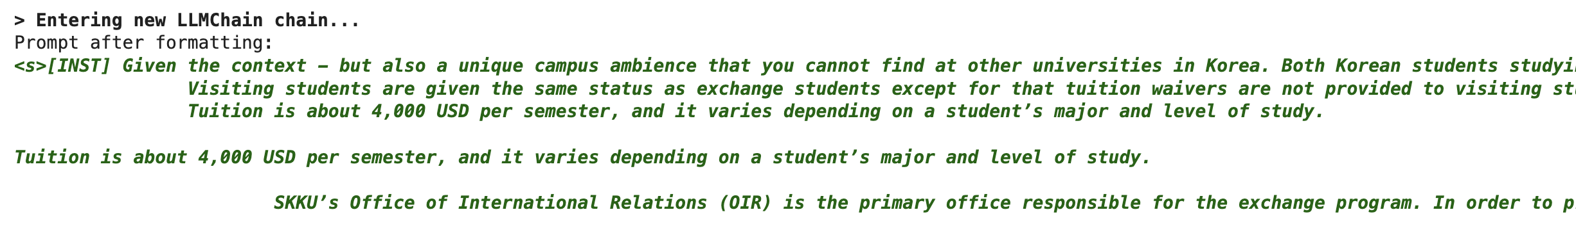
RAG – Generator
Demo Results
Successful Context Extraction
appropriate response based on given context

Slide 15
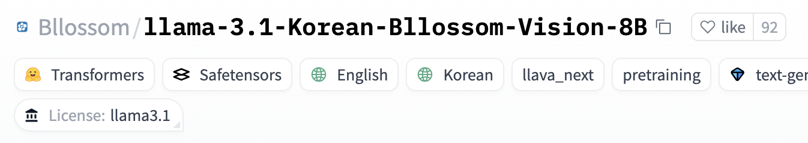
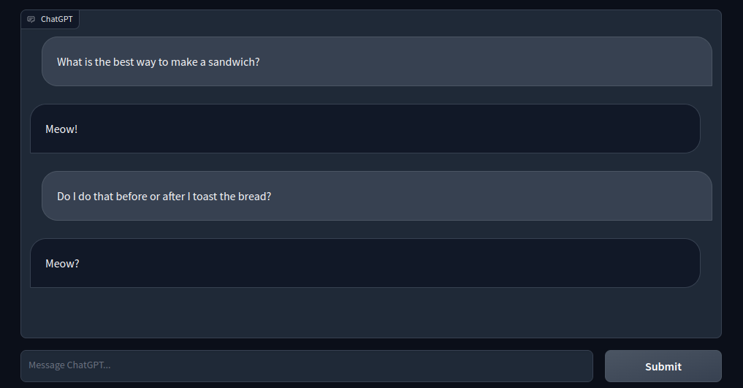

RAG – Generator
Areas for Improvement
Bilingual(English, Korean) should be used to understand Korean context – On Progress
UI/UX with Gradio – On Progress

Slide 16

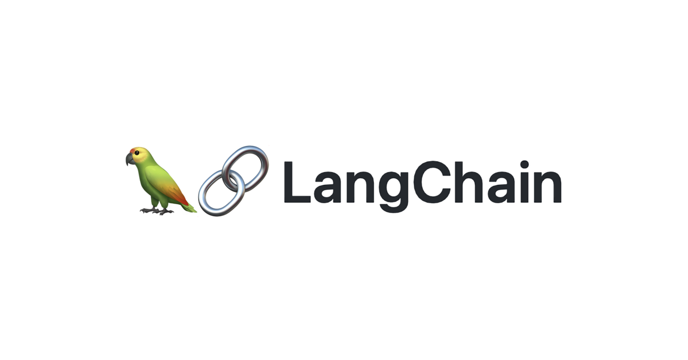
RAG – Generator
Areas for Improvement
External vector database – Langchain Connection – On progress

Slide 17
Scraping
04
Scraping and constructing database

Slide 18
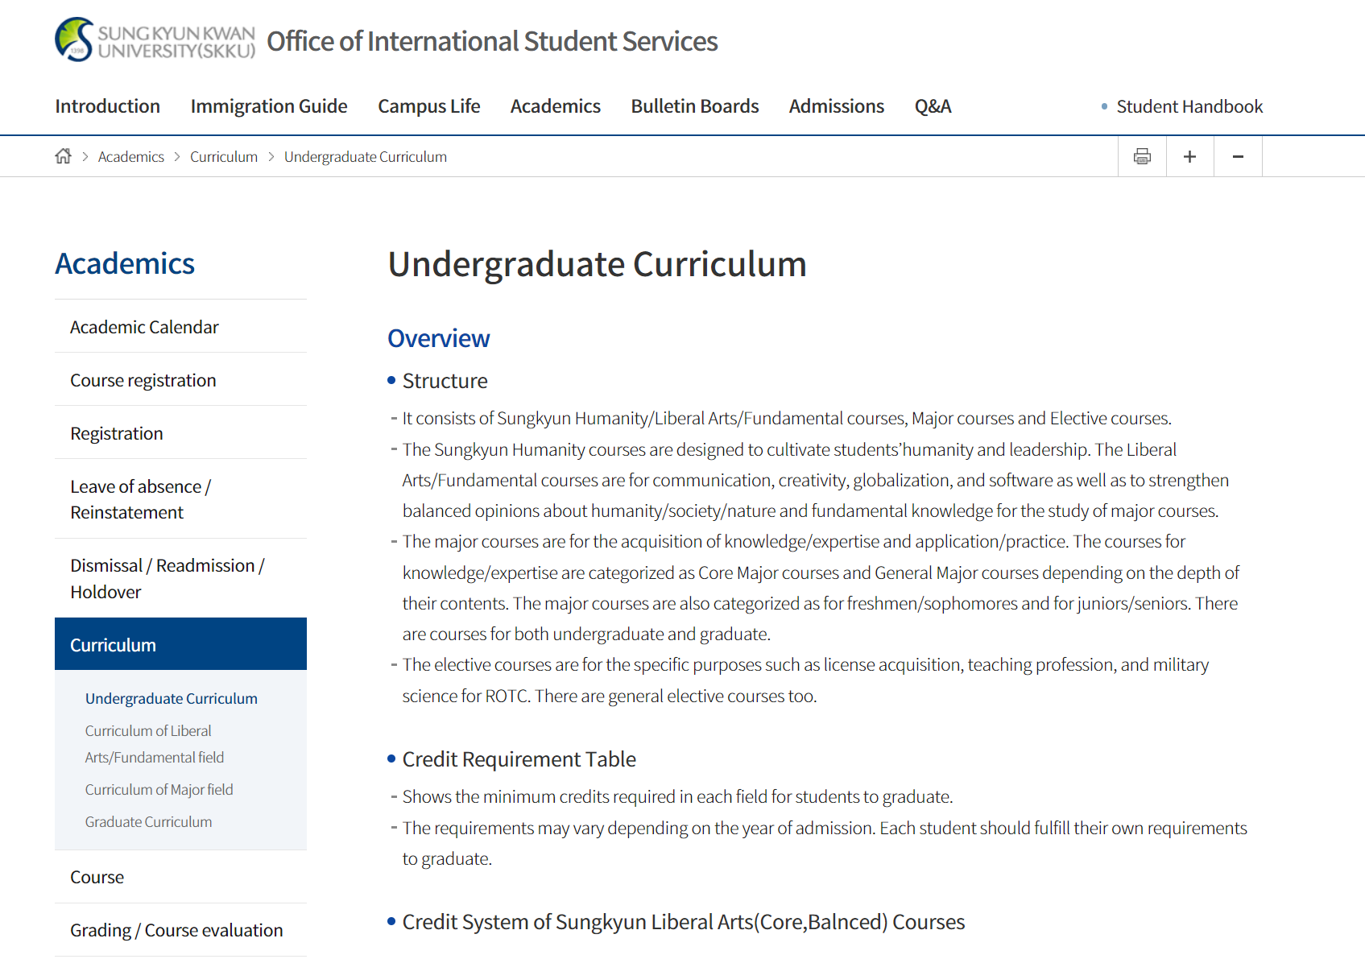
Scraping
Scraping web data using WebBaseLoader from langchain
SKKU homepage
Office of International Student Services
SKKLUB(Webpage not responding)
It consists of Sungkyun Humanity/Liberal Arts/Fundamental courses, Major courses and Elective courses.
The Sungkyun Humanity courses are designed to cultivate students’humanity and leadership. The Liberal Arts/Fundamental courses are for communication, creativity, globalization, and software as well as to strengthen balanced opinions about humanity/society/nature and fundamental knowledge for the study of major courses.
The major courses are for the acquisition of knowledge/expertise and application/practice. The courses for knowledge/expertise are categorized as Core Major courses and General Major courses depending on the depth of their contents. The major courses are also categorized as for freshmen/sophomores and for juniors/seniors. There are courses for both undergraduate and graduate.
The elective courses are for the specific purposes such as license acquisition, teaching profession, and military science for ROTC. There are general elective courses too.
…
WebBaseLoader
Notes:
We scrap data from webpages and pdfs relevant to skku. We’ve utilized WebBaseLoader from langchain to scrap web data. The webpage we scraped is, SKKU homepage, office of international student services, and skklub(which is currently not accessible).

Slide 19
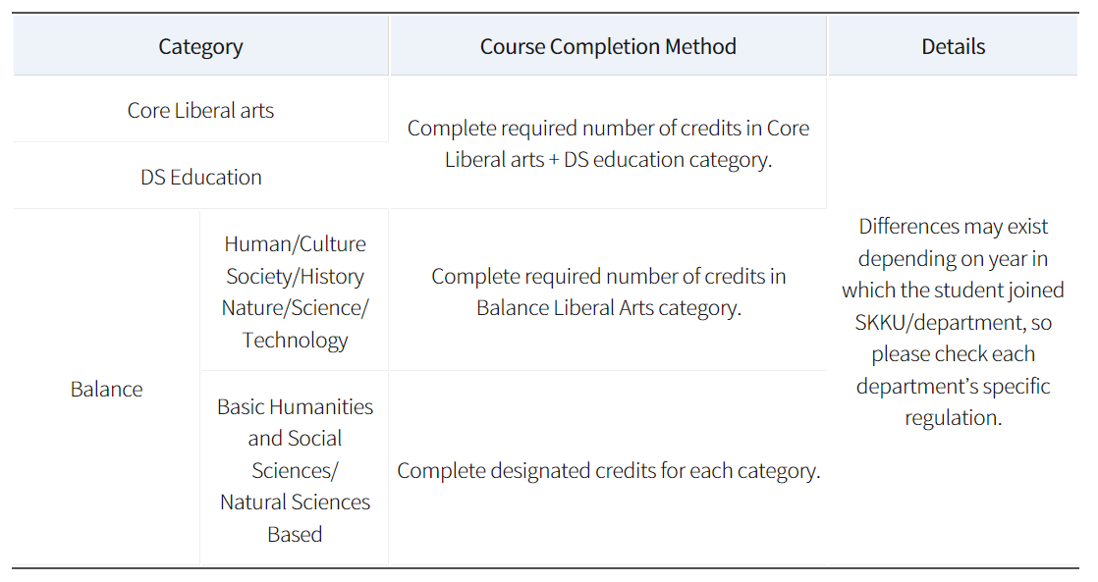
Scrapping
Cleaning the scraped data
Irrelevant data
Line breaks, white spaces, tabs
Encoding issues like "�" symbols
Table data(working in progress)
Notes:
However the scraped data has following problems. 1) It contains irrelevant information such as header and footer, but we only want the main content. 2) Line breaks, white spaces, tabs are not organized properly.
3) Some characters are not encoded properly.
4) Data in table format is not scraped properly.
We took cleaning process to address these problems, however we are still working on how to store table data scraped from the web.

Slide 20
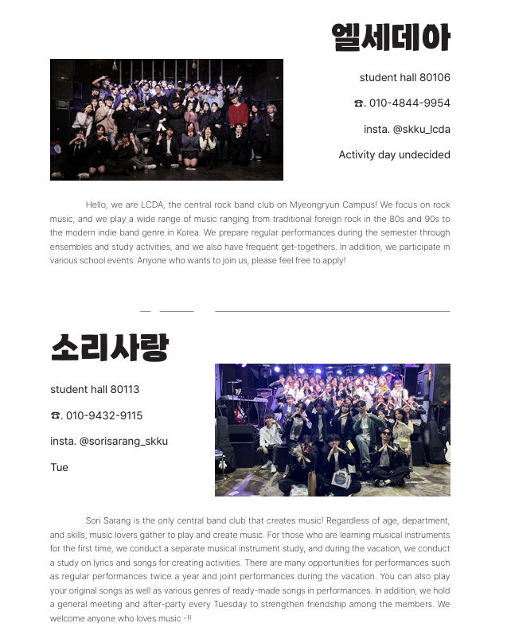
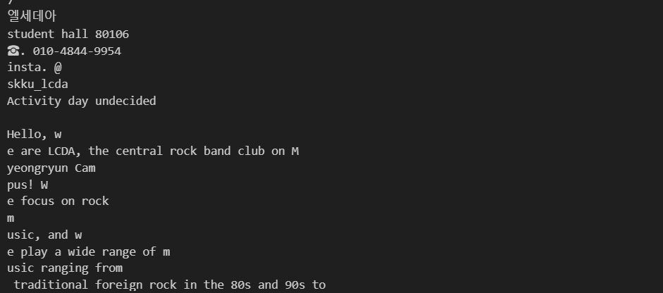
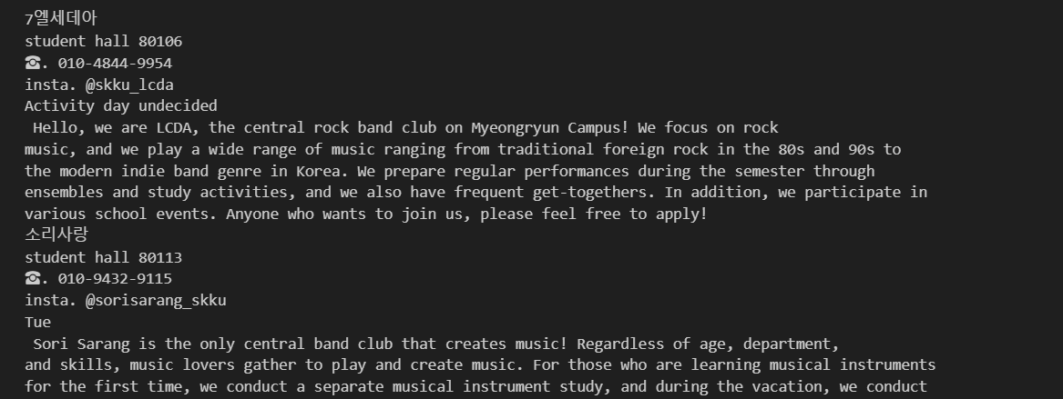
Scrapping
Scraping PDF data using PyPDFLoader from langchain
Used data: 2024 SKKU Club Guidebook, 2024 international student handbook
Trials
: PyMuPDFLoader, fitz
Wrong
format!
Selected method
: PyPDFLoader
Expected Format :)
Notes:
Tried some method to improve PDF text extracting performance: PyMuPDFLoader, fitz, PyPDFLoader
PyMuPDFLoader, fitz are faster than PyPDFLoader, but they returned wrong format.
We need a text in a good format for RAG to understand the context better than shortening the time. So we chose PyPDFLoader for PDF text extraction.

Slide 21

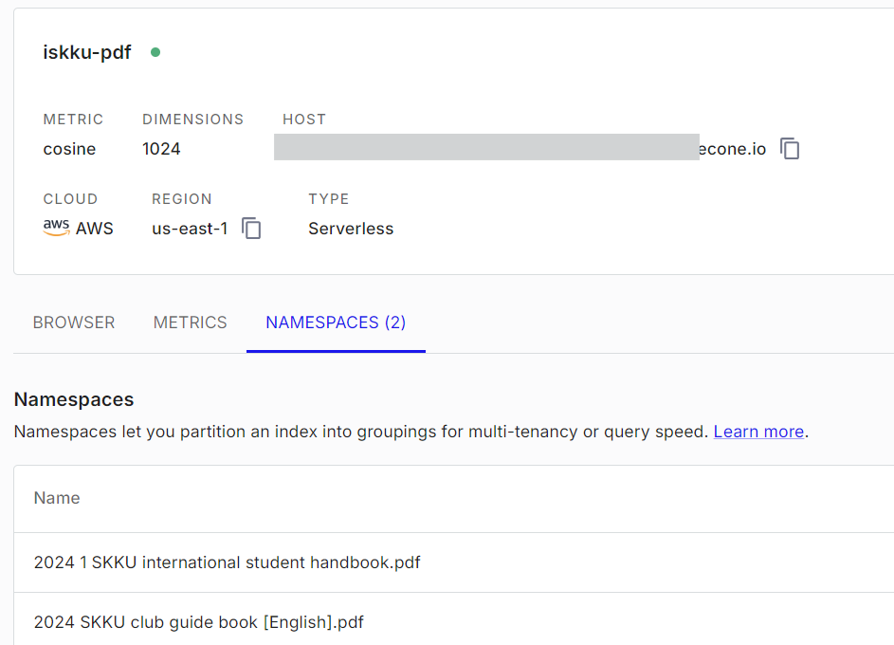
Database
Scraping results
(text)
Text split
(chunk_size 1000, chunk overlap 200)
embedding
(multilingual-e5-large-instruct)
Store in Pinecone
Notes:
Stored text data following these steps:
Prepare text data
Split text into chunks
Embedding chunks
Store chunks and embeddings in pinecone
We setted chunk size to 1000, chunk overlap 200 and chose multilingual 35 large by embedding model, but it can be changed depending on evaluation result.

Slide 22
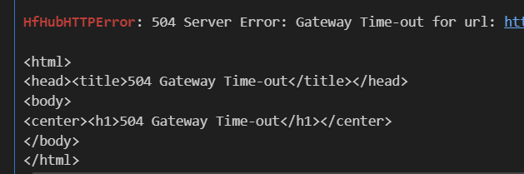
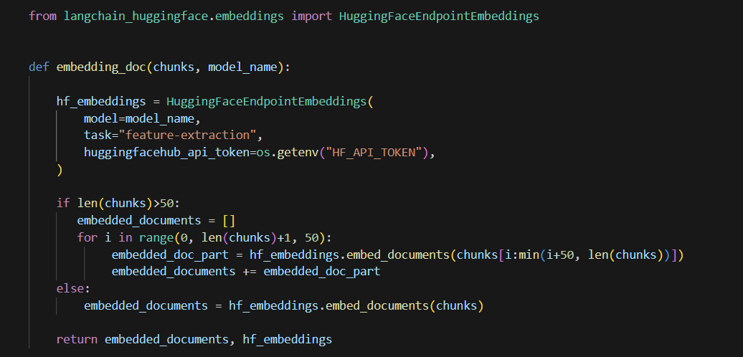
Database - Troubleshooting
Error
Solution
504 Server Error: Gateway Time-out
cause
Divide chunks into 50 chunks and pass them to the embedding model
Chunk List size is too large!
(Because some PDFs are over 160 pages)

Slide 23
Next Tasks
05
What will do next week

Slide 24
References:

Slide 25
Thank you!
Do you have any questions?

